Slide 1

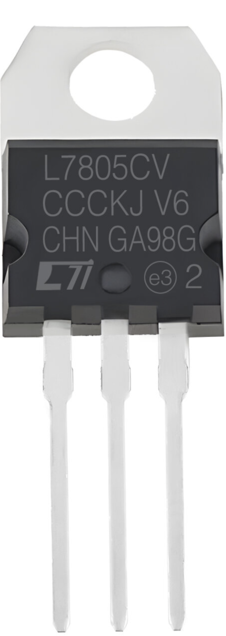
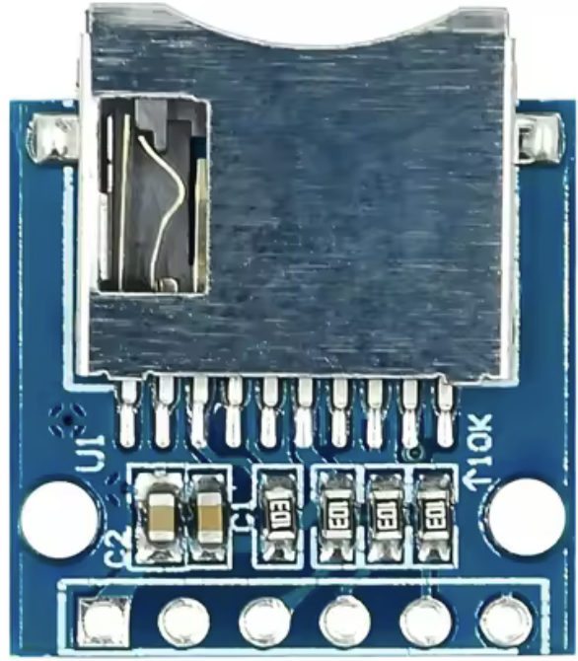
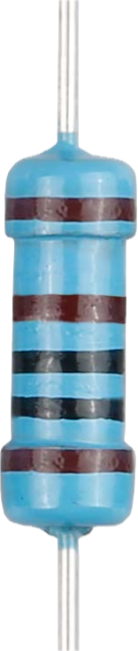
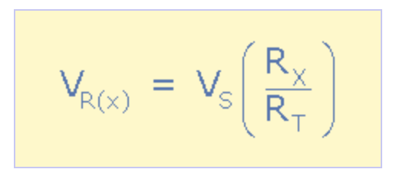
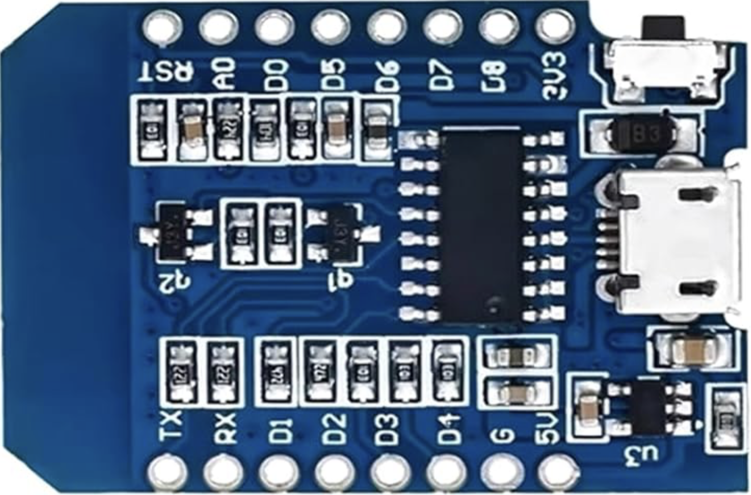
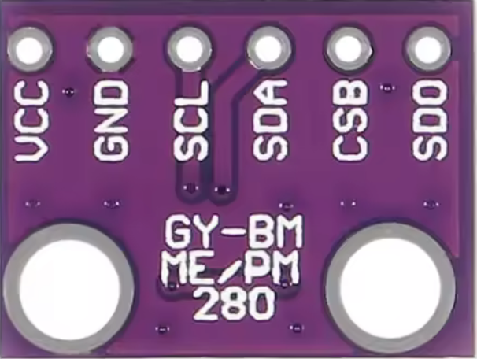
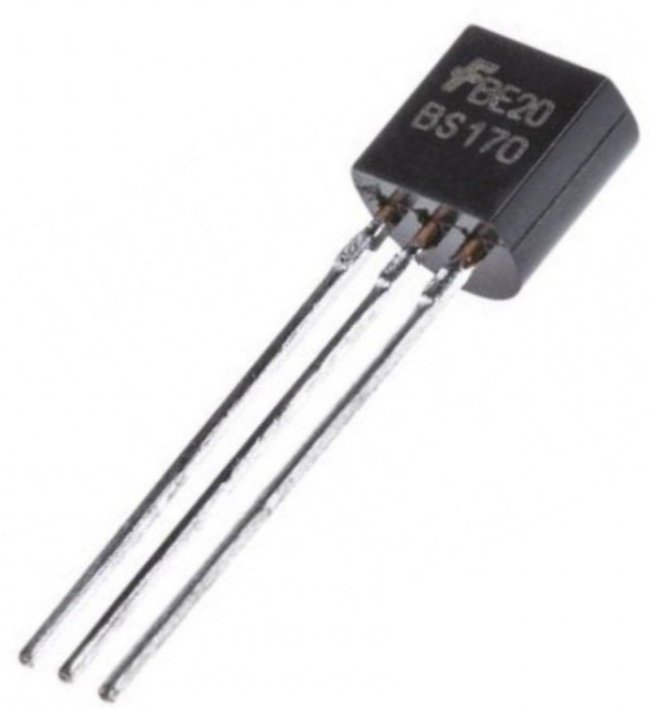
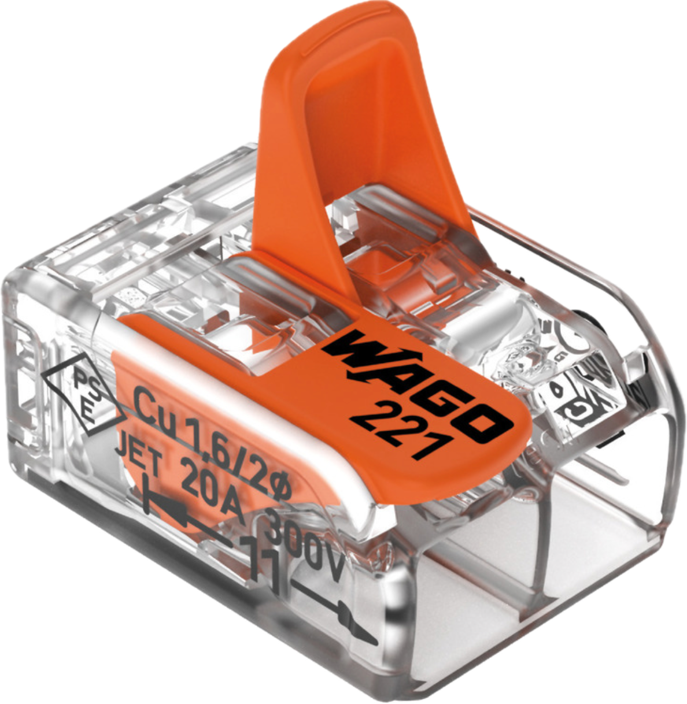
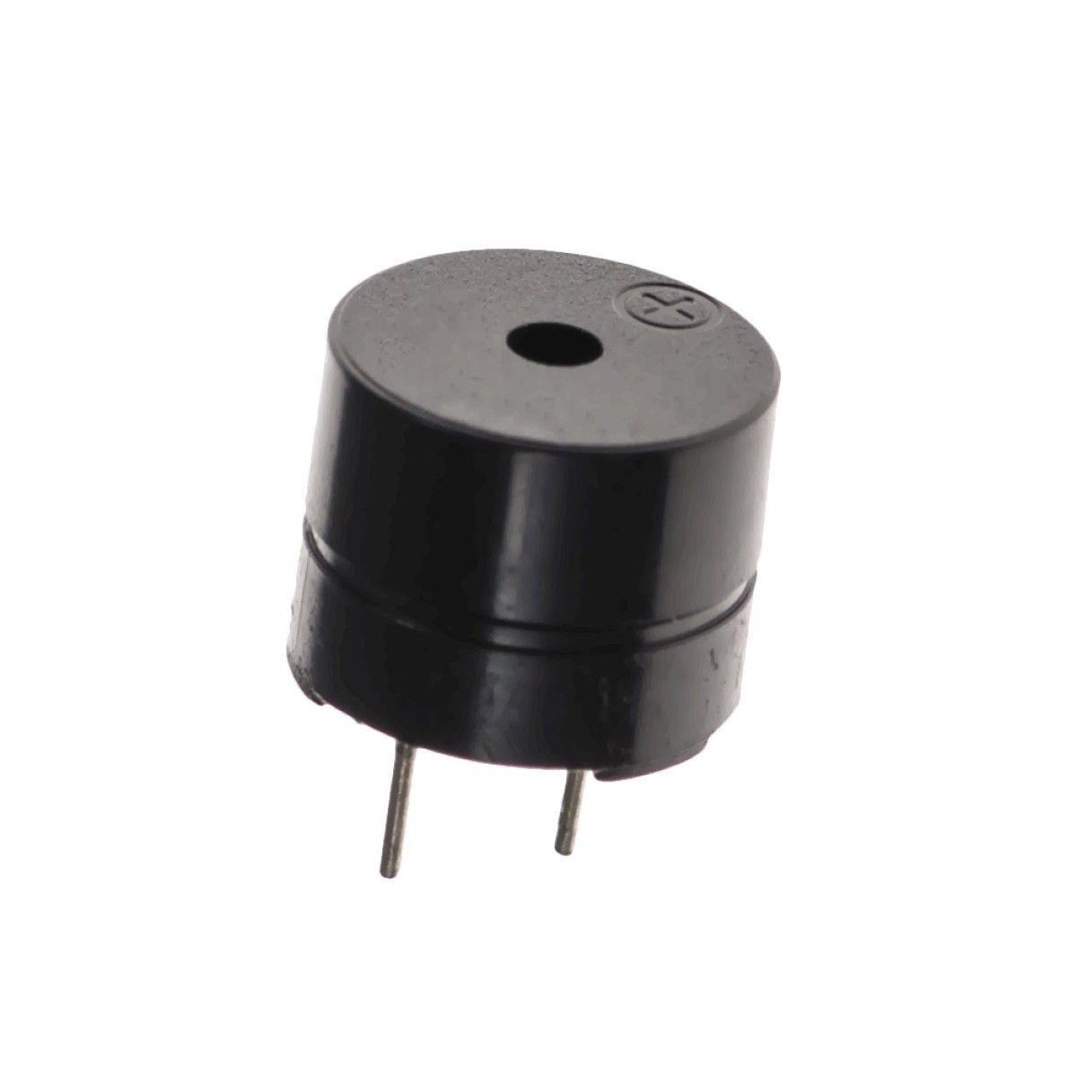
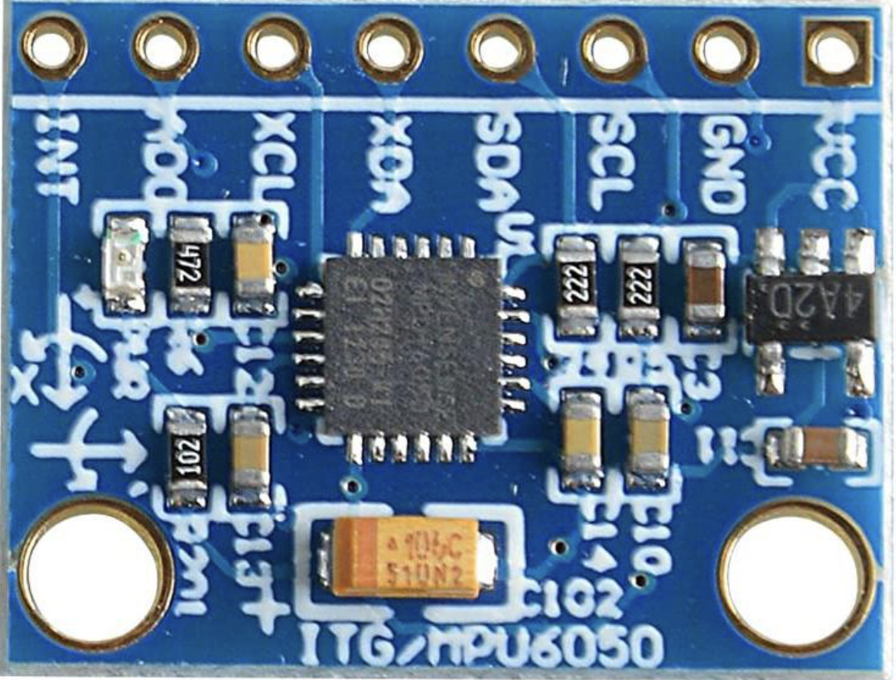
5V Regulator
9V battery
SD Card reader
Switch
+
GND
MISO
CLK
-
MOSI
CS
3v3
Detect power
100k ohm
BMP280
330k ohm
BS170 MOSFET
PYRO1
1k ohm
MPU6050 6-axis accelerometer
BS170 MOSFET
Buzzer
9V
PWM
ESP8266
I2C
3.3V
-
+
5V
1k ohm
GND

Slide 2
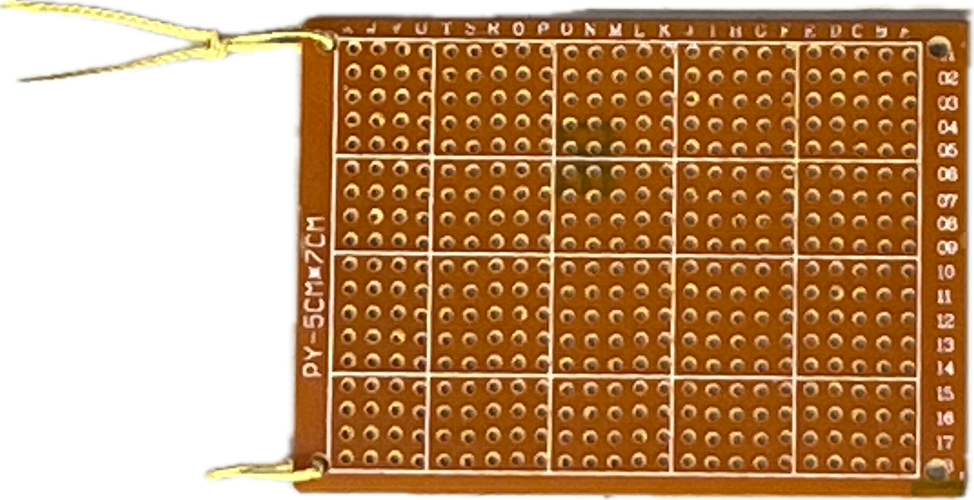
5v reg

